Slide 1
International Agreements LI: Identify Australia’s international agreements and how they affect Australian citizens. SC: Define international treaty and provide examples to support your definition.

Slide 2
http://www.abc.net.au/btn/story/s4847734.htm
Write these questions in your notes, don’t forget to leave space to answer them while you are watching the video.
1. What is a treaty?
2. And why do a lot of people think it's an important thing to have?

Slide 3
International Treaties
A treaty is an international written agreement between nation states.
International conventions to decide on treaties:
The World Heritage Convention
International Convention on the Elimination of All Forms of Racial Discrimination
The Convention on the Rights of the Child

Slide 4

The Importance of International Treaties for Australia
Increased globalisation means international treaties are becoming more important.
Negotiating international treaties allows Australia to have a global voice.

Slide 5

The impact of treaties upon Australia
Signing a treaty does not make it legally binding.
It only becomes law if that country decides to incorporate it into their laws.

Slide 6
The World Heritage Convention
WHC
Adopted in Paris 1972
Seeks to preserve sites of outstanding universal value.
Responsibility to preserve and protect heritage sites.
World Heritage List

Slide 7
World Heritage List Map
https://whc.unesco.org/en/interactive-map/

Slide 8
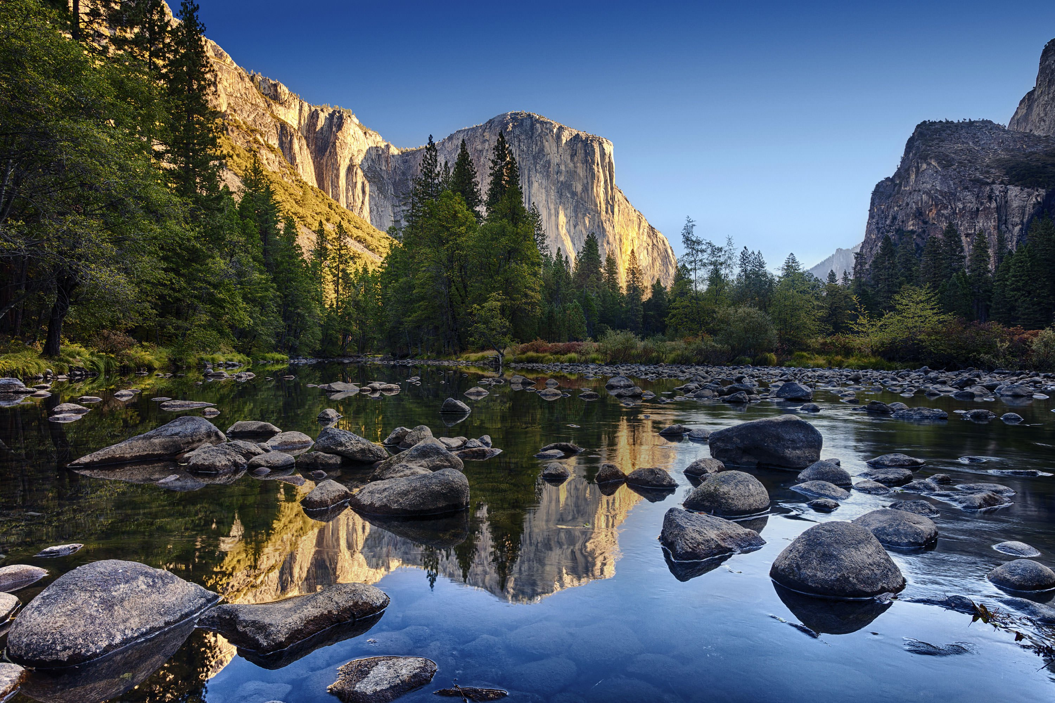
Yosemite National Park, USA

Slide 9
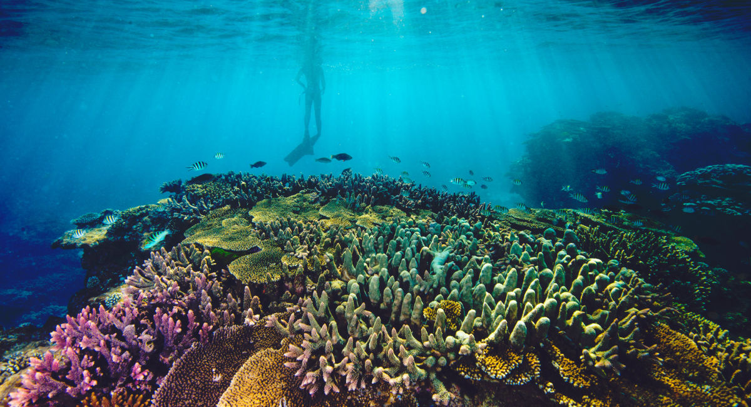
Great Barrier Reef, Australia

Slide 10

Kakadu National Park, Australia

Slide 11
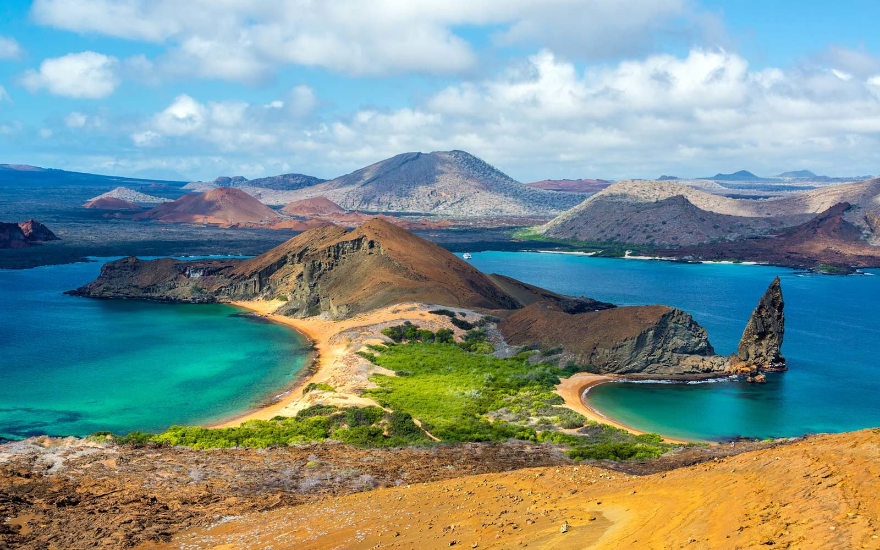
Galápagos Islands, Ecuador

Slide 12

Vatican City, Vatican City (Italy)

Slide 13
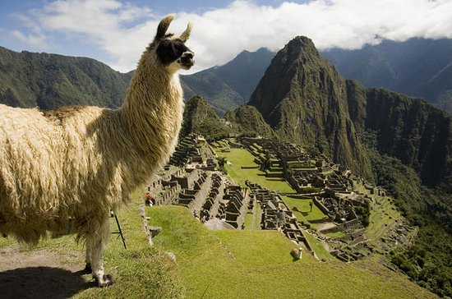
Machu Picchu, Peru

Slide 14
International Convention on the Elimination of All Forms of Racial Discrimination
CERD
Australia ratified the treaty on 30 September 1975.
Racial discrimination occurs when a person is given unequal treatment because if their race, colour, descent, ethnic origin or nationality.
This unfair treatment is a violation of human rights.

Slide 15
RECALL
What does CERD stand for?
What is a treaty?

Slide 16
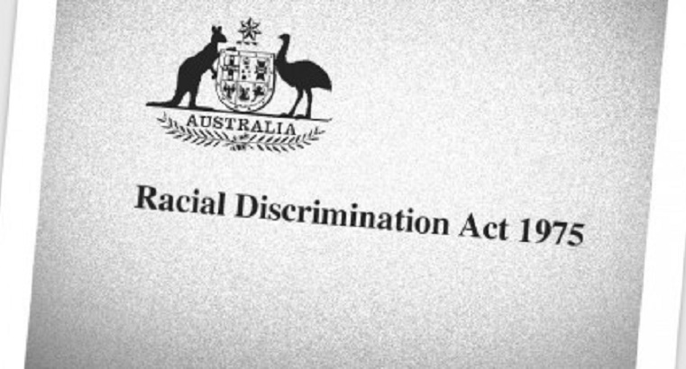
The implementation of CERD in Australia
The Racial Discrimination Act 1975
The RDA makes racial discrimination unlawful in Australia

Slide 17

International treaties: The Convention on the Rights of the Child
Signed 1989
Children are entitled to human rights in the same way that adults are.
Children have the right to protection, survival, health and education.

Slide 18
International Treaties: The Declaration on the Rights of Indigenous Peoples
Four main rights to indigenous peoples:
The right to self-determination
The right to be recognised as distinct peoples
The right to free, prior and informed consent
Right to be free of discrimination

Slide 19
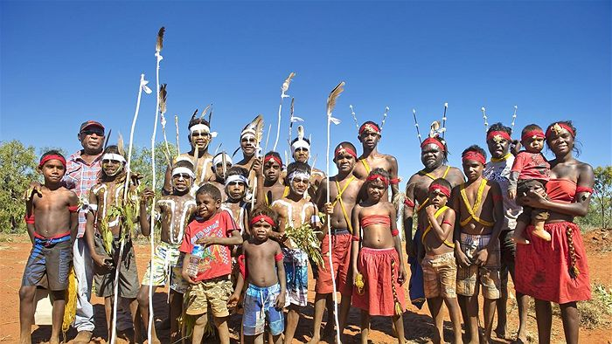
Australia

Slide 20
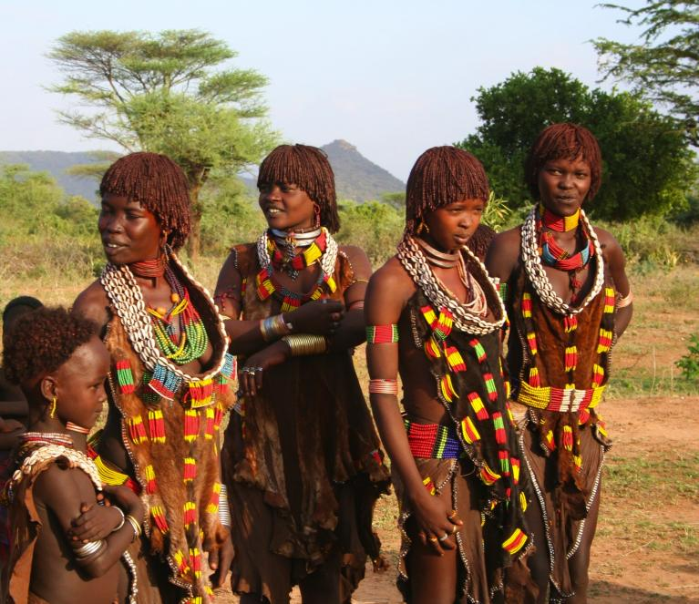
Africa

Slide 21
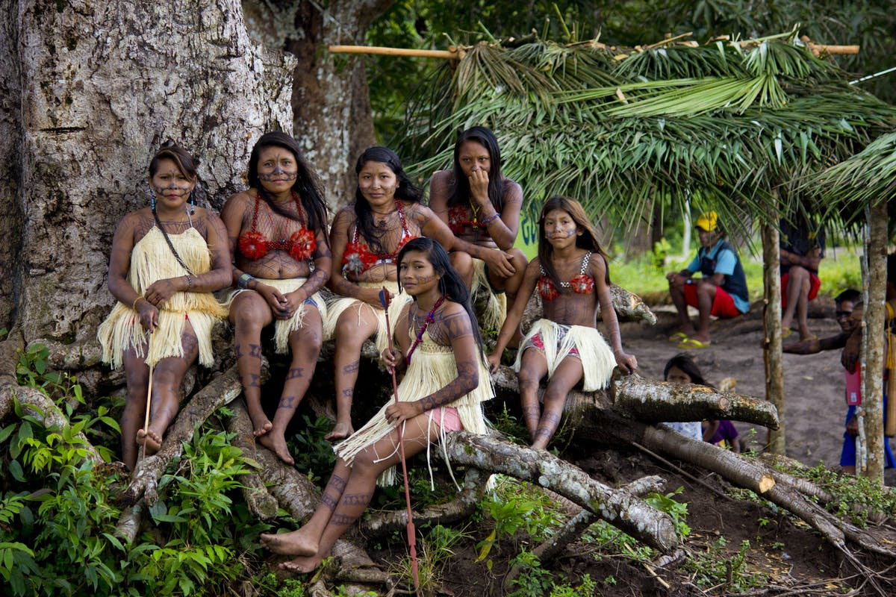
South America

Slide 22
Student Activity
Read the resource sheet you have been given and complete the key questions on the back.
Use pages 46-49 of the textbook to complete activities 1-4 on page 49.

Slide 23

https://create.kahoot.it/details/human-rights-in-australia/2c782f1e-f73e-4e6d-a510-6b664c6188a6

